Slide 1
Neurodiversity in the Workplace
Susanne M. Bruyère smb23@cornell.edu
Professor of Disability Studies and Academic Director,
Yang-Tan Institute on Employment and Disability, ILR School
IDEA Webinar
Friday, January 26, 2024
12:00-1:00pm Eastern

Slide 2
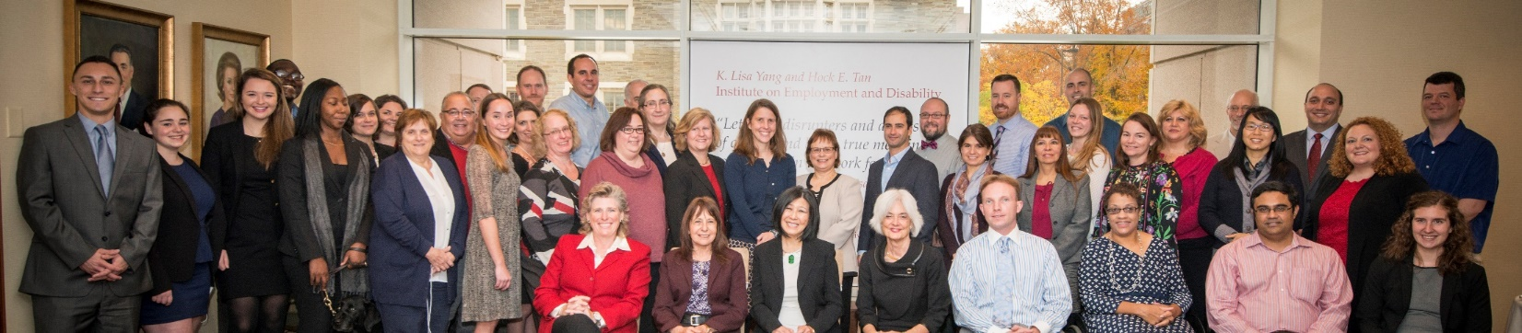
Yang-Tan Institute on
Employment and Disability
Focus on maximizing full inclusion of people with disabilities in employment and civil society
Enterprise unit
Conduct research and knowledge translation/diffusion activities
Multi-disciplinary team
70-member team
© 2024 Cornell University, ILR School, Yang-Tan Institute on Employment and Disability

Slide 3
Presentation Overview
Why an interest in neurodiverse job applicants and employees?
What is neurodiversity?
What are some considerations in the recruitment process?
What are ways to improve the interview experience of neurodiverse job candidates?
What are some ways to improve the success of neurodiverse employees throughout employment?
What are the implications for employers, recruiters, managers, co-workers and individuals with autism?
© 2024 Cornell University, ILR School, Yang-Tan Institute on Employment and Disability

Slide 4
Why an Interest in Neurodiversity?
An increasing number of neurodiverse individuals
  Prevalence rates of children with autism was 1 in 36 in 2020 (CDC, 2023)
  This is an increase of over 300% over 10 years
  Neurodiversity is estimated in to be approximately one in five in the general population
Individuals with autism are significant underemployed
Select Autistic individuals have difficulty navigating the employment process
Improved workplace neurodiversity inclusive practices can help
© 2024 Cornell University, ILR School, Yang-Tan Institute on Employment and Disability

Slide 5
Definitions Around Autism
Autism is the most common member of a family called autism spectrum disorders (ASD), also known as Pervasive Developmental Disorders (PDDs) (Shore, 2006).
Autistic disorder is classified in the Diagnostic and Statistical Manual, a reference published by the American Psychiatric Association, as having 6 or more symptoms from a list of 12 possible symptoms, which the manual groups into three areas: social interaction, communication, and behavior (Shore, 2006).
No two people with autism are the same: its precise form or expression is different in every case. Moreover, there may be a most intricate (and potentially creative) interaction between the autistic traits and the other qualities of the individual (Silberman, 2015).
Shore, S.M., & Rastelli, L.G. (2006). Understanding Autism for Dummies. Hoboken, NJ: John Wiley & Sons, Inc.
Silberman, S. (2015). NeuroTribes: The Legacy of Autism and the Future of Neurodiversity. New York, NY: Penguin Random House LLC.
© 2024 Cornell University, ILR School, Yang-Tan Institute on Employment and Disability

Slide 6
Definition of Neurodiversity
“Neurodiversity is a concept where neurological differences are to be recognized and respected as any other human variation. These differences can include those labeled with Dyspraxia, Dyslexia, Attention Deficit Hyperactivity Disorder, Dyscalculia, Autistic Spectrum, Tourette Syndrome, and others.” (National Symposium on Neurodiversity at Syracuse University. 2011)
Dyspraxia - physical coordination affected
Dyslexia – difficulty in reading or interpreting words
Attention Deficit Hyperactivity Disorder - inattention, difficulty focusing
Dyscalculia - difficulty in making arithmetical calculations
Autistic Spectrum - affects how a person acts and interacts with others, communicates, and learns
Tourette Syndrome - involves repetitive movements or unwanted sounds (tics) that can't be easily controlled.
© 2024 Cornell University, ILR School, Yang-Tan Institute on Employment and Disability

Slide 7
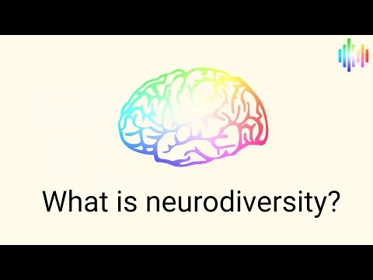
What is neurodiversity?
https://www.youtube.com/watch?v=xsfml3yVh1g
© 2024 Cornell University, ILR School, Yang-Tan Institute on Employment and Disability

Slide 8
Importance of Perspective
Like all characteristics, there is a spectrum of abilities for each individual
Many perceived limitations can also be assets
If organizations take a “neurodiversity perspective” to cognitive differences, workers can be accepted as a part of normal human variation
Important to create support and awareness for both the supervisor and the individual
Santuzzi, A. M. & Keating, R. T. (2022). Neurodiversity and the disclosure dilemma. In S. M. Bruyere and A. Colella (Eds.). Neurodiversity in the workplace: Interests, issues, and opportunities. (pp. 124-148). SIOP Organizational Frontier Series. Routledge.
© 2024 Cornell University, ILR School, Yang-Tan Institute on Employment and Disability

Slide 9
Focus on Autistic Job Seekers
Have higher levels of employment and underemployment than both people without disabilities and people with other types of disabilities
Disparities in employment exist for even for Autistic individuals who have above-average education and qualifications to the rest of the workforce
Employment interview remains most widely used selection methods
Employment interview particularly difficult for many Autistic job seekers
Companies are interested in being more successful
Saleh, M., Chang, H-Y., Bruyère, S. & Vogus, T. (2022). Neurodiverse applicant screening, interviewing and selection, in S. Bruyère & A. Colella, Neurodiversity in the Workplace, Society for Industrial Organizational Psychology Frontiers of Research Series. Oxfordshire, UK: Francis Group Publishers.
© 2024 Cornell University, ILR School, Yang-Tan Institute on Employment and Disability

Slide 10
Preparing the Workplace
Workplace climate for neurodiversity inclusion
Anticipate needed processes across the employment process –
  Recruitment (human capital)
  Selection, interviewing, making a good job match
  Job design, accommodations
  Career development and retention (training/development)
  Compensation and benefits
  Employee relations
  Health and safety
© 2024 Cornell University, ILR School, Yang-Tan Institute on Employment and Disability

Slide 11
Where is the Program Situated?
What might be the strengths and drawbacks/weaknesses of situating the program in the following departments:
Human capital/talent management?
Diversity and inclusion?
EEO/employment/labor relations?
Specific job/task/content area?
Health and safety/occupational health?
Disability case management?
Accommodation unit?
© 2024 Cornell University, ILR School, Yang-Tan Institute on Employment and Disability

Slide 12
Promising E-Recruiting Practices
Developing more sophisticated career websites that appropriately brand the organization’s hiring goals, contribute to more accurate and less exclusionary “self-selection” through employee testimonials, and giving potential recruits deeper insight into the company’s values and policies
Personalizing recruitment processes by allowing candidates to build up personal accounts on the website beyond an impersonal application form or procedure, and engage in applicant tracking that involves recruiters and other collaborators rather than relying solely on algorithmic filters
Saleh, M. (2020) Online Recruitment of and Outreach to People with Disabilities: Literature Review. Washington, DC: U.S. Department of Labor, Office of Disability Employment Policy,
Employer Assistance Resource Network.
© 2024 Cornell University, ILR School, Yang-Tan Institute on Employment and Disability

Slide 13
Barriers in the Job Interview Process and Interview Environment
  Types of questions asked (open-ended, hypothetical, personality profiles)
  Interview structure (large groups, multiple sequential interviews, long day(s))
  Environment (noisy, overstimulating)
  Recruiters, interviewers, and hiring managers rarely aware of affirmative hiring and trained to address interaction needs
Bruyere, S., Chang. H-Y, Saleh, M. (2020). Empowering Neurodiverse Populations for Employment Through Inclusion AI and Innovation Science: Policy and Practice Brief. Ithaca, NY: Cornell University, ILR School, Yang-Tan Institute. Available from https://ecommons.cornell.edu/handle/1813/104223
© 2024 Cornell University, ILR School, Yang-Tan Institute on Employment and Disability

Slide 14
Barriers for Autistic Job Seekers
Little prior experience in job interviews
Perhaps little prior work experience
Lack of familiarity with workplace setting
Challenged in addressing what was perceived to be ambiguous questions (what would you do if …?)
Difficulty explaining how skills address job requirements
Perhaps awkward with expected social interaction
Anxiety due to “camouflaging” or “faking” socially-appropriate responses
Bruyere, S., Chang. H-Y, Saleh, M. (2020). Empowering Neurodiverse Populations for Employment Through Inclusion AI and Innovation Science: Policy and Practice Brief. Ithaca, NY: Cornell University, ILR School, Yang-Tan Institute. Available from https://ecommons.cornell.edu/handle/1813/104223
© 2024 Cornell University, ILR School, Yang-Tan Institute on Employment and Disability

Slide 15
How Employers Can Assist
Employer strategies for more inclusive practice
  Autism-awareness and sensitivity training for HR and hiring professionals prior to interviews
  Modifying or replacing existing interview protocols
Examples of possible interview changes included:
  Providing interview questions to interviewee in advance
  Introduce applicants to the work environment prior to starting the interview as an “ice breaker.”
  Consider replacing interview panels with shorter, 1:1 or 2:1 interview settings
  Avoid “rapid-fire” questioning strategies
  Eliminate “open-ended” and “vague” interview questions
  Allow opportunities to show technical skills by solving a specific, work-relevant problem
Bruyere, S., Chang. H-Y, Saleh, M. (2020). Empowering Neurodiverse Populations for Employment Through Inclusion AI and Innovation Science: Policy and Practice Brief. Ithaca, NY: Cornell University, ILR School, Yang-Tan Institute. Available from https://ecommons.cornell.edu/handle/1813/104223
© 2024 Cornell University, ILR School, Yang-Tan Institute on Employment and Disability

Slide 16
How Individuals Can Better Prepare
  Pre-interview preparation (access to questions and ability to practice skills)
  Preparation on how to present skills in interview process
  Preparation in how to demonstrate skills or build a portfolio of examples of demonstrated expertise
  Prepare for select social interface expectations (prepared responses)
  Build self-advocacy skills (ask for accommodations or breaks, if needed; ask for time to think to answer questions; etc.
  Service providers work with employers/recruiters to build their knowledge of neurodiversity and explore willingness to alter the traditional interview process (breaks, questions in advance, clarification of unclear questions)
Bruyere, S., Chang. H-Y, Saleh, M. (2020). Empowering Neurodiverse Populations for Employment Through Inclusion AI and Innovation Science: Policy and Practice Brief. Ithaca, NY: Cornell University, ILR School, Yang-Tan Institute. Available from https://ecommons.cornell.edu/handle/1813/104223
© 2024 Cornell University, ILR School, Yang-Tan Institute on Employment and Disability

Slide 17
Possible Neurodiversity Hiring Program Stakeholders
Top management/CEO
Designated champion
Employees who are family members
Supervisors
Job applicants
Family members of job applicants
Community service providers
Other?
© 2024 Cornell University, ILR School, Yang-Tan Institute on Employment and Disability

Slide 18
Factors Hindering Career Advancement for Neurodiverse Individuals
Nature of neurodiversity identity (e.g. present since birth, later diagnosis, identity?) Usually least important
The person’s own engagement in self-limiting behaviors (e.g., choosing not to participate in career advancement opportunities)
Stereotypes and stigmas affecting opinions about competence, limiting chances for growth placements
Membership in another minority group and resulting multiple stigmas
© 2024 Cornell University, ILR School, Yang-Tan Institute on Employment and Disability

Slide 19
Preparing Supervisors for Neurodiverse Talent
Companies that have implemented Autism at Work initiatives have explored a wide variety of ways to equip supervisors for success, both prior to and during their involvement with the program.
Some companies are creating internal training programs.
Others are accessing emerging external vendor-developed programs.
Companies sometimes have supervisors join the new employee recruits in their own one to six-week screening and orientation programs.
Companies may also conduct targeted internal training of several hours or longer to orient supervisors to the company’s expectations for the program and the attendant role that the company expects the supervising manager to play.
Consultation services and related training programs are materializing to support companies in this process and complement their internal efforts.
(DXC Technology 2016a.; Integrate Advisors 2019; Tim Goldstein 2019; and Uptimize 2019).
© 2024 Cornell University, ILR School, Yang-Tan Institute on Employment and Disability
Notes:
From Module Two

Slide 20
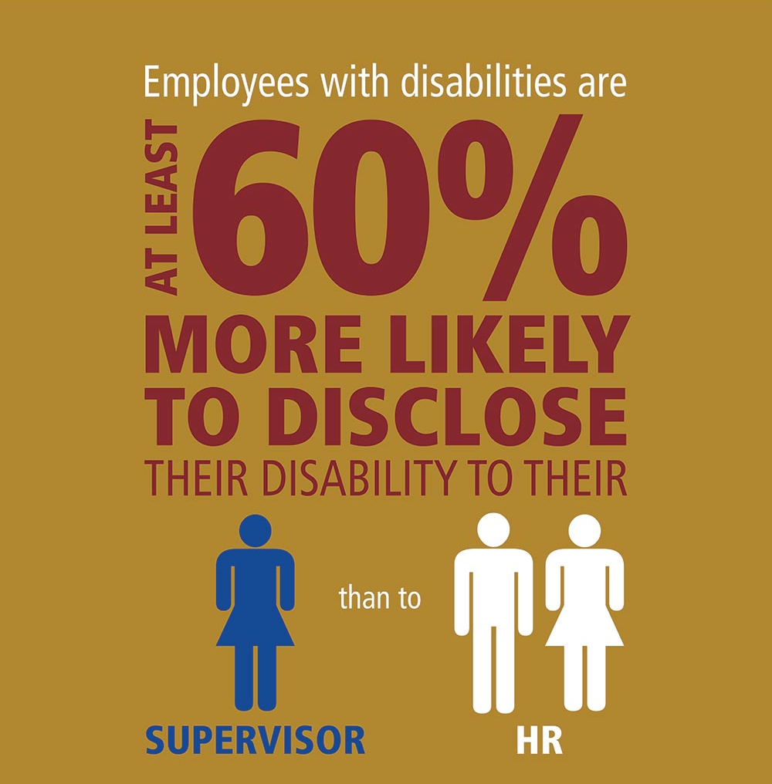
Disclosure Infographic
© 2024 Cornell University, ILR School, Yang-Tan Institute on Employment and Disability

Slide 21
Self-Disclosure Considerations
In order to benefit from legal protections and accommodations, employers need to know that the individuals qualify as a neurodivergent person
Neurodivergent characteristics are largely concealable, thus workers must willingly disclose
Disclosure decisions are not easy and may require careful consideration about benefits and costs
May result in “identity management” behaviors, that require a great effort and loss of accommodations
Work environment primary factor predicting disclosure
Santuzzi, A. M. & Keating, R. T. (2022). Neurodiversity and the disclosure dilemma. In S. M. Bruyere and A. Colella (Eds.). Neurodiversity in the workplace: Interests, issues, and opportunities. (pp. 124-148). SIOP Organizational Frontier Series. Routledge.
© 2024 Cornell University, ILR School, Yang-Tan Institute on Employment and Disability

Slide 22
Questions When Exploring Accommodations
What limitations is the employee experiencing?
How do these limitations affect the employee and the employee’s job performance?
What specific job tasks are problematic as a result of these limitations?
What accommodations are available to reduce or eliminate these problems, and are all possible resources being used to determine possible accommodations?
Has the employee been consulted regarding possible accommodations?
Once accommodations are in place, would it be useful to meet with the employee to evaluate the effectiveness of the accommodations and to determine whether additional accommodations are needed?
Do supervisory personnel and employees need training?
Job Accommodation Network/JAN, 2019 in Patton, 2022.
© 2024 Cornell University, ILR School, Yang-Tan Institute on Employment and Disability

Slide 23
Organizational Elements in Retention/Career Development/Performance Mgt. Processes
Clear job descriptions and clear performance expectations and timelines
Training for supervisors
  Equitable opportunities for career development
  Regular feedback
  Ways to approach behavior/performance issues
  Other?
Mentoring systems, buddy systems, facilitate social networking, other?
© 2024 Cornell University, ILR School, Yang-Tan Institute on Employment and Disability

Slide 24
Employee/Business Resource Groups
Most effective when senior management lends support
Can assist with candidate recruitment, identifying supervisors, willing mentors/buddies, etc.
Help to identify barriers/issues; assist with finding solutions
Support for families or newly–diagnosed individuals
Can bring significant business value when product development and marketing assigned (e.g., focus groups for design issues)
Partner/network with other diversity groups
© 2024 Cornell University, ILR School, Yang-Tan Institute on Employment and Disability

Slide 25
Importance of Communications
A company's communications, marketing, and branding departments can support an neurodiversity inclusion in a number of ways.
Program brand-building
Leveraging company intranet
General internal awareness
Messaging
Program spotlighting
Event planning; use naturally-occurring celebrations (UN International Day of Persons with Disabilities, Dec. 3; UN Autism Awareness Day, April 2)
© 2024 Cornell University, ILR School, Yang-Tan Institute on Employment and Disability

Slide 26
Designing for Neurodiversity Inclusion Across the Employment Process
Building the Pipeline
Supervisor Preparation/Training
Engaging Internal Supports
Performance Management
Interviewing/Hiring
Communication Campaign
Sustainability
Preparing the Workplace
Recruitment
Onboarding
Accommodation Process
Engaging External Supports
Retention
Career Advancement
Scaling
© 2024 Cornell University, ILR School, Yang-Tan Institute on Employment and Disability

Slide 27
Assessing Progress Across the Employment Process
Readying the workplace
Recruitment, interviewing, hiring, orientation, training
Supervisor role, preparation, and support
Retention, career development, progression
Workplace neurodiversity and inclusion
Use of external community resources
Use of internal organizational resources
Internal and external communication
Sustainability and scalability decisions
© 2024 Cornell University, ILR School, Yang-Tan Institute on Employment and Disability

Slide 28
Online Recruitment Related Resources
Online Recruitment of and Outreach to People with Disabilities: Research-Based Practices https://production-askearn-org.s3.amazonaws.com/EARN_2020_Online_Recruitment_Outreach_Disability_Research_Based_Practices_d5f8f3154a.pdf
Encouraging Applicants with Disabilities: Job Descriptions and Announcements https://production-askearn-org.s3.amazonaws.com/EARN_Explainer_Job_Descriptions_Checklist_ab47437635.pdf
Disability Outreach and Inclusion Messaging: Assessment Checklist for Career Pages https://production-askearn-org.s3.amazonaws.com/EARN_Career_Pages_Checklist_bc6e290e2f.pdf
Company Website Disability Inclusion Messaging: Observations of Job Seekers with Disabilities https://production-askearn-org.s3.amazonaws.com/EARN_2021_Tool_Job_Seeker_Observations_9210d2a7f0.pdf
Inclusive Branding and Messaging https://askearn.org/page/inclusive-branding-and-messaging
© 2024 Cornell University, ILR School, Yang-Tan Institute on Employment and Disability

Slide 29
Neurodiversity Related Resources
Bruyere, S., & Colella, A. (Eds.) (2022). Neurodiversity in the Workplace: Interests, Issues, and Opportunities. Neurodiversity in the Workplace, Society for Industrial Organizational Psychology Frontiers of Research Series. Oxfordshire, UK: Francis Group Publishers.
Gregory, J. (Host), Bruyere, S. (Guest). (2022, September 8). Neurodiversity in the workplace: A competitive DEI advantage. [Audio podcast]. Project HR. https://projectionsinc.com/neurodiversity-in-the-workplace/
Saleh, M., Chang, H-Y., Bruyère, S. & Vogus, T. (2022). Neurodiverse applicant screening, interviewing and selection, in S. Bruyere & A. Colella, Neurodiversity in the Workplace, Society for Industrial Organizational Psychology Frontiers of Research Series. Oxfordshire, UK: Francis Group Publishers.
Bruyere, S., Chang. H-Y, Saleh, M. (2020). Empowering Neurodiverse Populations for Employment Through Inclusion AI and Innovation Science: Policy and Practice Brief. Ithaca, NY: Cornell University, ILR School, Yang-Tan Institute. Available from https://ecommons.cornell.edu/handle/1813/104223
DXC Technology Dandelion Program Online Information at Cornell University eCommons, available from https://ecommons.cornell.edu/handle/1813/72826.
Neurodiversity in the Workplace Tool Kit. Employer Assistance and Resource Network on Disability Inclusion. Available from https://askearn.org/page/neurodiversity-in-the-workplace.
Neurodiversity@Work Employer Roundtable, Disability:IN. Available from https://askearn.org/page/neurodiversity-work-employer-roundtable
© 2024 Cornell University, ILR School, Yang-Tan Institute on Employment and Disability

Slide 30
Funding Acknowledgements
The Employer Assistance and Resource Network on Disability Inclusion (EARN) is a resource for employers seeking to recruit, hire, retain, and advance qualified employees with disabilities. This publication is fully funded by the U.S. Department of Labor’s Office of Disability Employment Policy(ODEP) under cooperative agreement No. 23475OD000002-01-00 with Cornell University. The total five-year cost of this agreement amounts to $10,000,000. This document does not necessarily reflect the views or policies of the U.S. Department of Labor, nor does mention of trade names, commercial products, or organizations imply endorsement by the U.S. Government.
Track B-1 (AI and Future Jobs) Empowering Neurodiverse Populations for Employment through National Science Foundation (NSF) Inclusion AI and Innovation Science (B-6970), RAISE C-Accel Phase I Grant funded to Vanderbilt University, Frist Center for Autism and Innovation, Nashville, TN; PTE Federal Award No.: 1936970, Subaward No.; UNIV61108. Ithaca, NY: Cornell University, ILR School, K. Lisa Yang and Hock E. Tan Institute on Employment and Disability.
© 2024 Cornell University, ILR School, Yang-Tan Institute on Employment and Disability

Slide 31

QUESTIONS?
© 2024 Cornell University, ILR School, Yang-Tan Institute on Employment and Disability

